Slide 1
Functions, Callbacks, and returns!
-Ashell Fernando | LinkedIn: /in/ashell-fernando | Portfolio: entofmd.github.io

Slide 2
What I’d like for you to do..
Don’t have the mentality of ‘thinking outside the box’. In fact, don’t even think there’s a box, because you are putting yourself in that box if you do.
I think, therefore I am - René Descartes

Slide 3
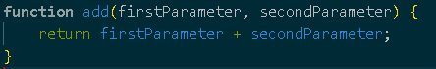
First of all, what is a Function?
Functions are one of the fundamental building blocks in JavaScript. A function is a JavaScript procedure—a set of statements that performs a task or calculates a value. To use a function, you must define it somewhere in the scope from which you wish to call it.
In Javascript, functions are OBJECTS.

Slide 4
Big Word: First Class Functions
What are First Class Functions?
Anything you can do with other types (objects, strings, numbers, booleans, etc..), you can do with functions.
i.e: Assign them to variables, pass them around as parameters to other functions, create them on the fly!
First class functions change the way we can program, they can open up horizons to completely different approaches to solving problems. This is why there is no single solution to any problem.
2

Slide 5
Hold up.. Functions are OBJECTS?!
Just like any object in JS, it resides in memory. It’s a special type of object though, because it has all the features of a normal object and has some other special properties.
Special Properties:
Name - optional, can be anonymous.
Code - Where the lines of code you write sit.
The code you write gets placed into a special property of the function object. It isn’t like the code you write is the function. The function is an object with other properties. The code you write is just one of those properties that you’re adding on to it.
What makes Code special is, it’s “Invocable” (). Meaning, you can tell it to run the code sitting on that property.
3

Slide 6
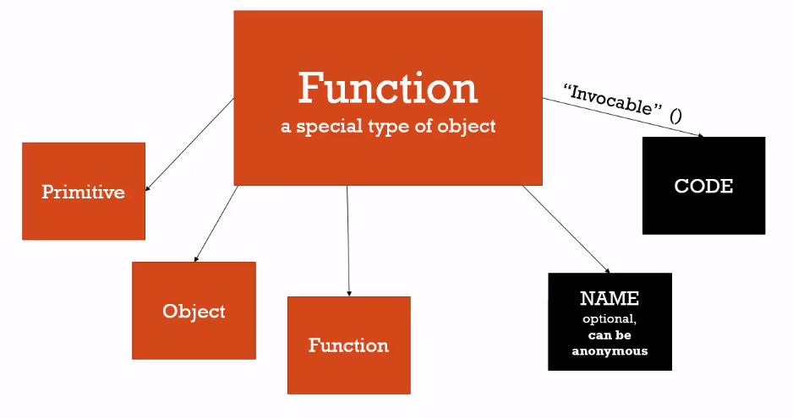
It is imperative that you have this mental model of a function in your mind.
You have to think of a function as more than just this container of code. It’s an object, as such, you can pass it around. It has properties, and it has methods. Why?
Say it with me: In Javascript, FUNCTIONS ARE OBJECTS.

Slide 7
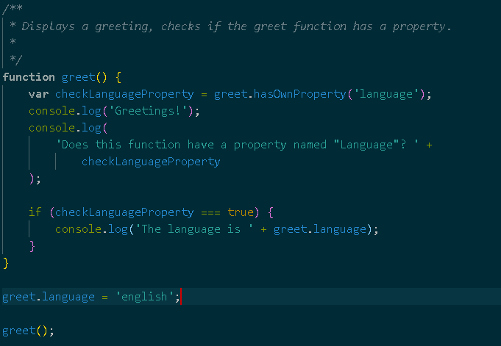
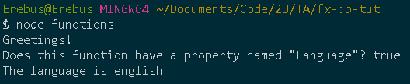

Slide 8
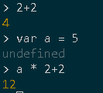
Function Statements and Function Expressions
Big Word: Expression - A unit of code that results in a value. It doesn’t have to save to a variable.
Statements just do work. Any expression in JS ends up creating a value.
Can anyone name an example of a statement? if-else statement

Slide 9
More on function statements and expressions
Statements:
The function is placed into memory, but it’s just a statement.
It doesn’t return a value until the function is executed.
Expressions:
Can be named or anonymous function that gets created on-the-fly!
Returns a value

Slide 10
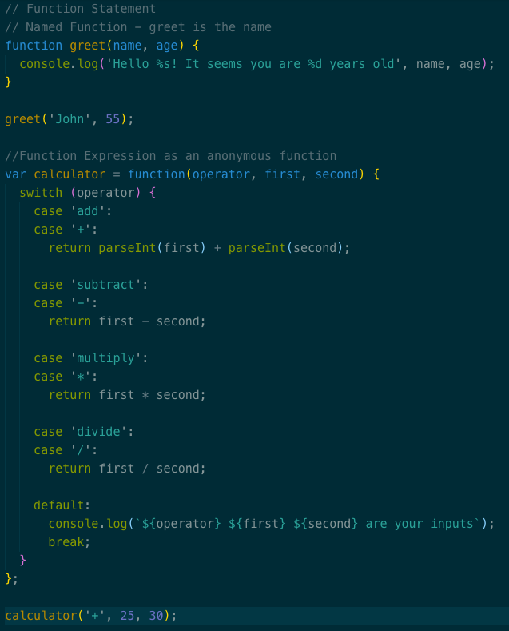
Function statements and expressions example

Slide 11
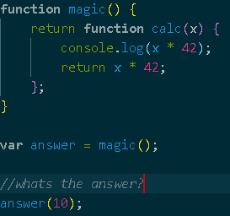
Returns
Ex: return [[expression]];
The return statement ends function execution and specifies a value to be returned to the function caller.
The expression whose value is to be returned. If omitted, undefined is returned instead.
A function immediately stops at the point where return is called.

Slide 12
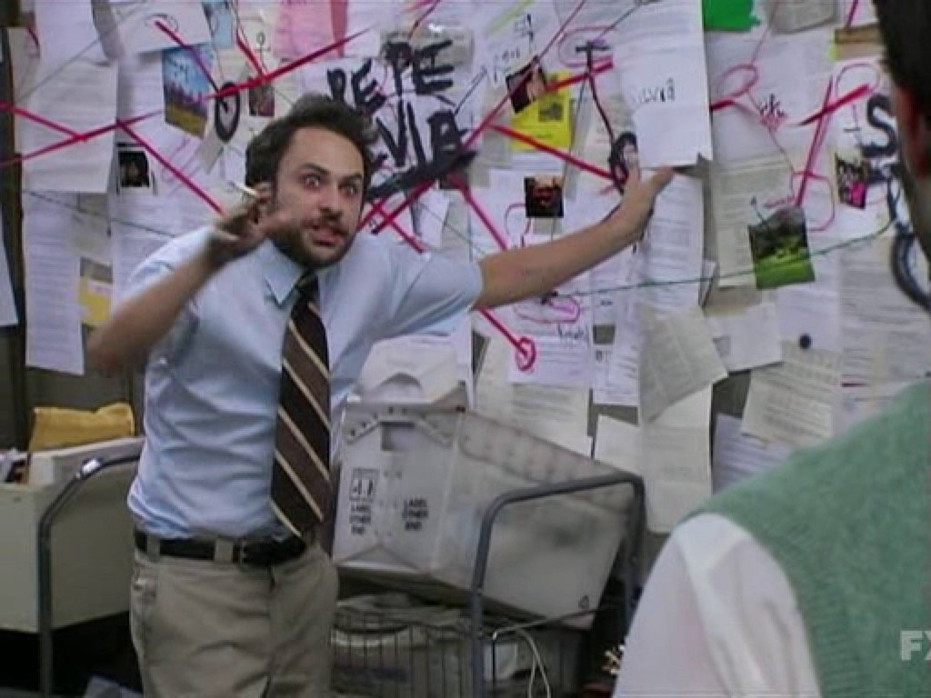
The notorious Closures...
Before we begin, I’m going to be blunt with you. This topic is very notorious, and you’ll see why. Closures is a JS topic that’s absolutely vital to understand if you’re going to advance at all in understanding and writing the language.
You might not get the understanding of Closures at first, but as you keep on coding, you will come across it. Then it will click!
To be clear, in order for you to truly understand this, you’d need to know how First class functions work, you’d need to understand the execution stack, and the execution context.
If you’d like, we can have a Closure specific lab.
The reason I’m covering Closures is to build up to Callbacks

Slide 13
Big word: Callback functions
Callback Function: A function you give to another function, to be run when the other function is finished.

Slide 14
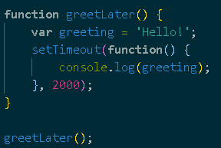
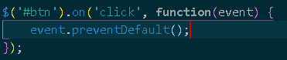
You might have been using Closures and Callbacks without knowing.
Do these look familiar:

Slide 15
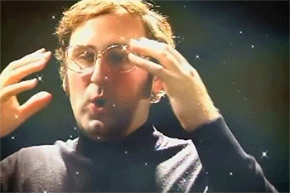
Hopefully everything makes sense now
If it doesn’t, don’t fret! As you climb the ladder of a developer, you will definitely come across the topics we covered here today. You might have used them in the past, but you probably didn’t know what they were called.

